Slide 1
Optimization Applications For Super Mario Bros.
Made By: Kevin Zheng, Harley Vispo,
and Thomas Frederick

Slide 2
Why Super Mario Bros.
We wanted to focus specifically on routing and glitches rather than damage boosting since damage boosting is not applicable to every game, while generally finding the proper routing along with glitches are essentially to speedrunning any game.
Super Mario Bros. is a good example of such, in that damage boosting does not exist while routing and glitches employed are essential to the speedrunning of the game, where there are also multiple sources for this game to back up our claims.

Slide 3
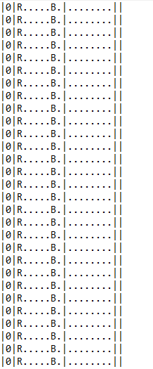
Issues that we ran into
TAS refused to replay properly
TAS creation complexity
Each input has to be created frame by frame
60 frames per second, or 1 interaction per 1/60th of a second
18000+ frames
-adapted
Lack of optimal hardware to create a TAS run

Slide 4


Slide 6
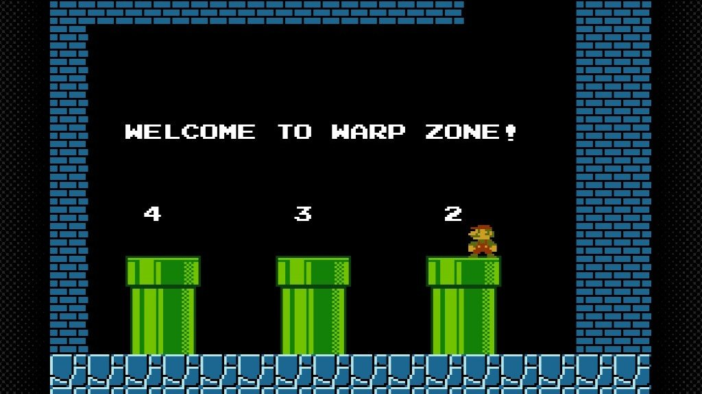
Routing
1-1 & 1-2
1-1 Pipe
1-2 Warp Zone
4-1 & 4-2
4-2 Warp Zone
All Of World 8
Final world

Slide 7
Comparing The Routes
Time of the speedruns in perspective.
18:36.78 - Warpless TAS Speedrun
4:54.032 - TAS Any% Speedrun
5:02.55 - TAS Glitchless Speedrun
On average, it takes 2 hours for a casual playthrough of the game
Main reason for such a difference
Any% speedruns allows the usage of warp pipes
Warpless speedrun does not allow the uses of warp pipes, therefore all worlds must be completed and would take longer
Glitchless speed runs does not allow the uses of glitches

Slide 8
Glitches & Exploits
Flagpole Glitch
Frame perfect glitch to skip flagpole animation to save time.
Wall Clipping
Run through walls. Seen on 1-2
Minus World - A glitched level that never ends
Minus world is what can happen if you perform some glitches incorrectly, specifically involving warp pipes.
Wrong Warp
Using a warp to get to another warp unintentionally. Ie. using a pipe to go up a vine
Wall Jumping
If Mario's foot catches on a wall or pipe, he can jump again to do the Wall Jump at that frame.

Slide 9
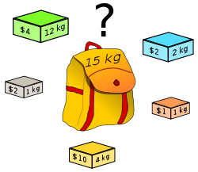
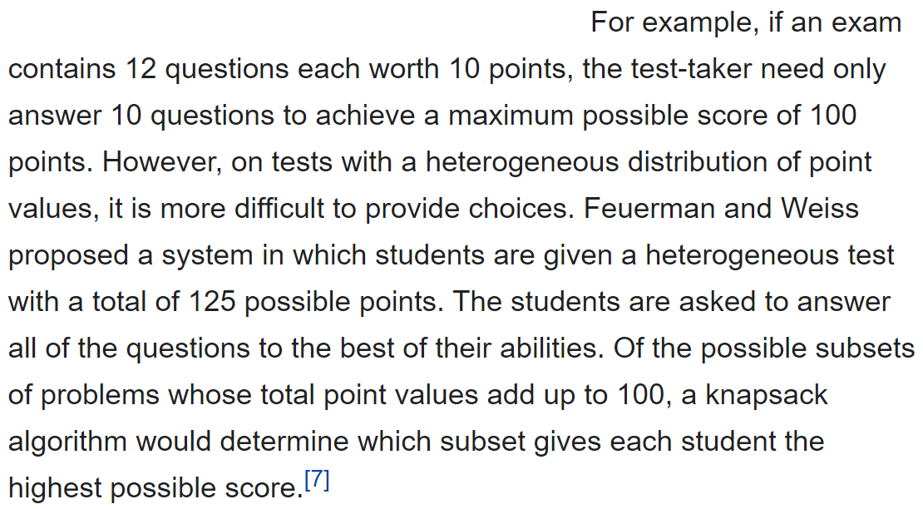
Knapsack Problem
The Knapsack problem is an excellent example of optimization.
In layman’s terms, it’s a way to depict your choices and its effects on optimization.
Maximization of rewards for the minimum amount of effort required
An example provided by wikipedia to further understand the knapsack problem

Slide 10
Knapsack Application
Events
Breaking Down Game Into Events
Decisions In Response To Events
Notable decisions
Flagpole glitch/bullet bill glitch vs non-glitched
Wall jump glitch vs normal jumps
Wall clipping vs normal walking
Wrong warp vs intended warping

Slide 11
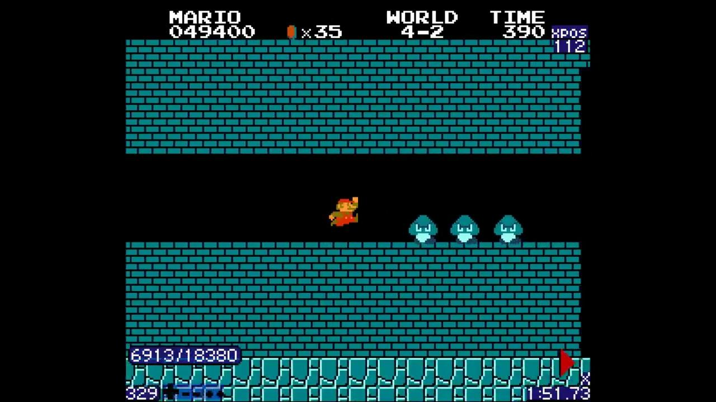
Speedrun Comparison
Glitchless Run Glitch Run

Slide 12
Any Questions and / or Comments?

Slide 13
Bibliography
https://www.mariowiki.com/List_of_Super_Mario_Bros._glitches
https://www.youtube.com/watch?v=sNBWxmItfpU Any% TAS run
https://www.youtube.com/watch?v=Zn0unJPFtqI Glitchless TAS run
https://drops.dagstuhl.de/opus/volltexte/2018/8818/pdf/LIPIcs-FUN-2018-27.pdf
https://www.speedrun.com/smb1/guide/09v5d
https://www.youtube.com/watch?v=sNBWxmItfpU&ab_channel=Nobodycallsmetubby
Notes:
Where nagatoro slide
Reeee

